Slide 1

SMART GRADER
SPRING 2022 CAPSTONE PROJECT | DELIVERABLE-5
GUIDED BY-PROF.HENRY WONG

Slide 2

Team Members
AKANKSHYA BISWAL
EMI HARRY
GIO ABOU JAOUDE
JONATHAN ANGAMARCA
JOSEPH DOUGAL
JOSE SALCEDO
RITHVIK SUBRAMANYA
TJ RABBANI
WAHIDUR RAHMAN

Slide 3

Agenda
Overview
Sprint 4 Vs Sprint 5
Sprint 5
New Technologies
Product Backlog
Timelines
Retrospectives
Conclusion
Notes:
Project Description and Project Components
Technologies used in the project
Market Analysis
User personas
Milestone timeline
Retrospective: things that worked

Slide 4
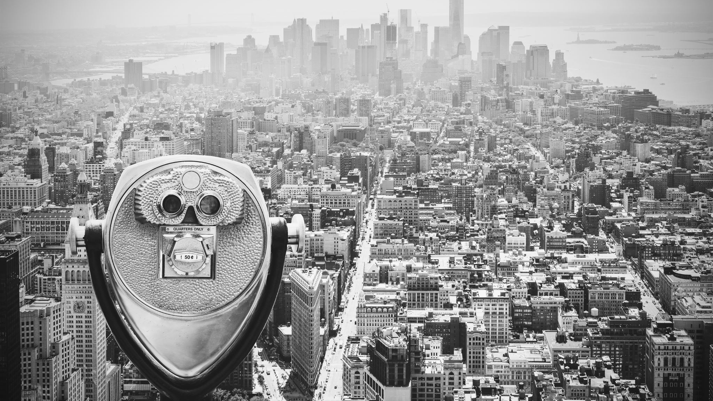
Overview

Slide 5

WHAT IS SMART GRADER?
A website that can generate and grade answers to math and essay type assignment questions.
Easier and faster to upload and grade assignments for students.
Teachers can generate questions for students with built-in math generator.
Students can access places in the required textbooks based on NLP hints.
NLP is used to generate and score text-based questions and answers.
Grades can be checked by all users.
Alert students and teachers about homework posted and submitted.
JOSE SALCEDO

Slide 6

Minimal Viable Product(MVP)

Slide 7
STEP1
Login as an Educators/Students/Others.
If the user is an Educator, they can post the questions and the answers for the questions to review.
If the user is a student, go to the assignment page and click on the 'take me to the text' button, which will take you to the textbook pages, where you will most likely find the answers.
For Others(Teachers/Organization they can review their children/Students academic progress.
STEP2
STEP3
For Teachers, after each student submits the assignment, they will get a notification. They can go to the assignment page and click on the 'verify' button, which will give them the score for each student.
Students will get a notification once the teachers have posted the assignments, and then they can write the answers and submit them.
STEP4
Teachers can randomly review any student's answers to verify, and students can check their assignments after they have received grades from teachers and logout from the application.
JONATHAN ANGAMARCA

Slide 8

Persona 1-College Student
Name : Monica
Age : 19 – 21 years old
Status : Grad student
Problem : No time to study due to work.
Solution : Signs up for Smart Grader. Inputs question and is directed to the answer section in the relevant textbook.
JONATHAN ANGAMARCA

Slide 9

Persona 2-School Teacher
Name : Jack
Age : 34 – 36 years old
Status : High School History Teacher
Problem : Has too many papers to grade.
Solution : Signs up for Smart Grader. Inputs question and relevant text. Smart Grader does the rest.
JONATHAN ANGAMARCA

Slide 10
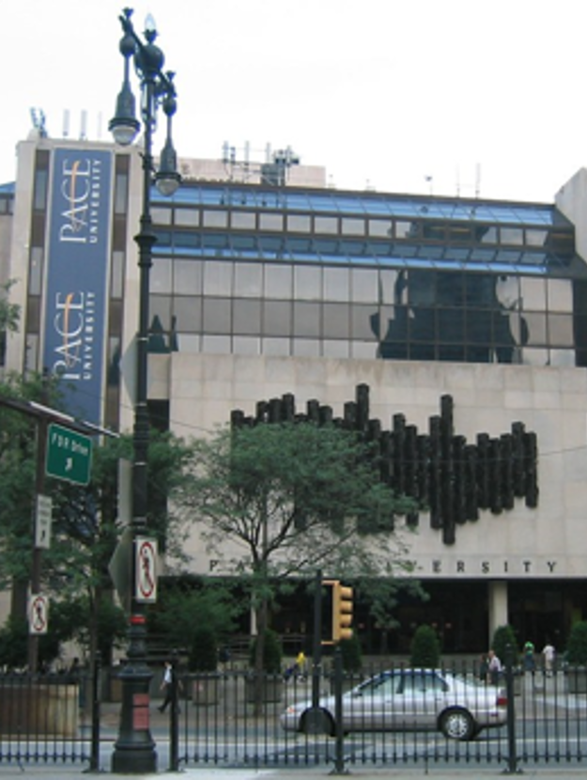
Persona 3-Dept. Head of an Organization
Name : Mathematics Dept. Head at Pace University
Status : Dept. Head
Problem : Needs to understand decline in students' performance.
Solution : Dept. Head signs up for Smart Grader. Can visualize students' performance and see the questions asked by each professor.
RITHVIK SUBRAMANYA

Slide 11

Persona 4-Working Parent
Name : Katy
Age : 42 – 45 years old
Status : Parent
Problem : Worried about child's academic performance.
Solution : Sign up for Smart Grader. Can view child's progress (strengths and weaknesses).
RITHVIK SUBRAMANYA

Slide 12
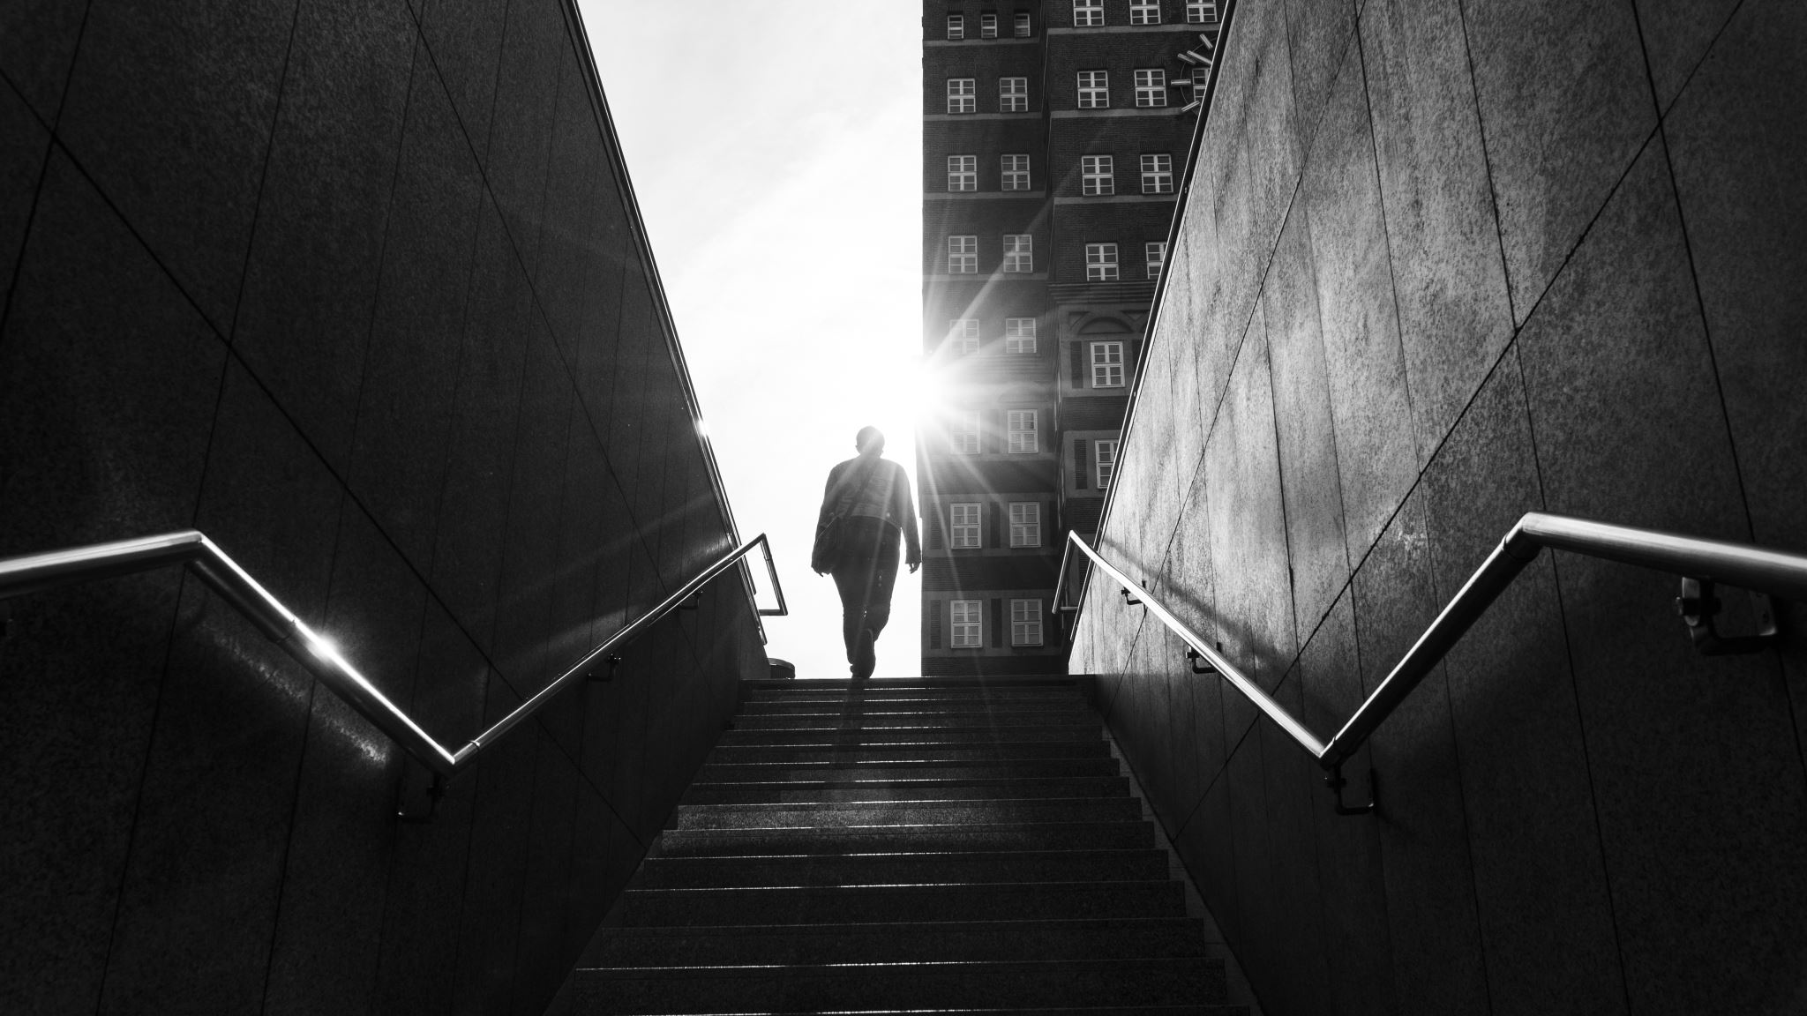
LOOKING FORWARD INTO THIS SEMESTER

Slide 13

This semester our team has plans to undertake an extensive focus on adding various features to Smart Grader to make it more user friendly. These features may include:
Add users like H.O.Ds and Parents.
Essay-based questions and answer grading.
Enable teachers to upload documents like class notes/textbooks.
Direct students to the part of textbook/notes that corresponds to the question.
Add paywall to the application
RITHVIK SUBRAMANYA

Slide 14

Sprint 4 Vs Sprint 5

Slide 15
Comparison
Sprint 4
Sprint 5
We completed our machine learning algorithm for math-based questions.
Created two user groups-Student and Educator and provided different level of access for both.
Educators were able to generate, delete and submit the math questions.
Students were able to load test and update answers in the application.
Users were able to generate report.
We have aligned the pricing section and the feature button on the login page of Smart Grader.
We have fixed the "logout" button on the homepage of Smart Grader.
We have fixed the "Subject" button on the homepage which will display the list of subjects for the users.
We have added the paywall criteria, but it is yet to be implemented.
We have completed our machine learning algorithm for essay-based questions.
GIO ABOU JAOUDE

Slide 16

Sprint 5

Slide 17

New Technologies
Advanced AI: BERT based Natural language understanding(NLU) model for essay-based questions and answer grading.
GIO ABOU JAOUDE

Slide 18
Committed Task and Stories
Task/Story | Key | Summary | Story Points | Priority
Story | Key-1​8 | As a Parent, I want to create a parent user account so that I can check my child's grades on Smart Grader. | ​5 | High
Task | Key-5​ | Find any login issues in the student and teacher's account. | ​ | High
Story | Key-20​ | As the head of a Math department, I want to create a separate user account to check the progress of the department's students. | 4 | High
Story | Key-9 | As an educator I should be able to upload the textbook pdf. | 8 | Highest
Task | Key-12​ | Link all user stories, test cases, acceptance criteria together. |  | Low
Task | Key-6​ | Create the burndown chart for last and this semester. |  | Low
Task | Key-17 | Create presentation for Sprint 5 |  | Low
AKANKSHYA BISWAL

Slide 19
Completed Tasks and Stories
Task/Story | Key | Summary | Story Points | Priority
Story | Key-1​0 | As an educator, I want to get the update on the new features that are added to the Smart Grader application. | ​3 | High
Task | Key-7 | Created presentation for Sprint 5 | ​ | Low
Story | Key-8 | As a student, I want to logout from the application after successfully submitting my homework but was unable to logout. | 5 | High
Story | Key-20 | As an educator, I want to get a list of all the subjects for which I would be able to create assignments for the students. | 20 | Highest
AKANKSHYA BISWAL

Slide 20
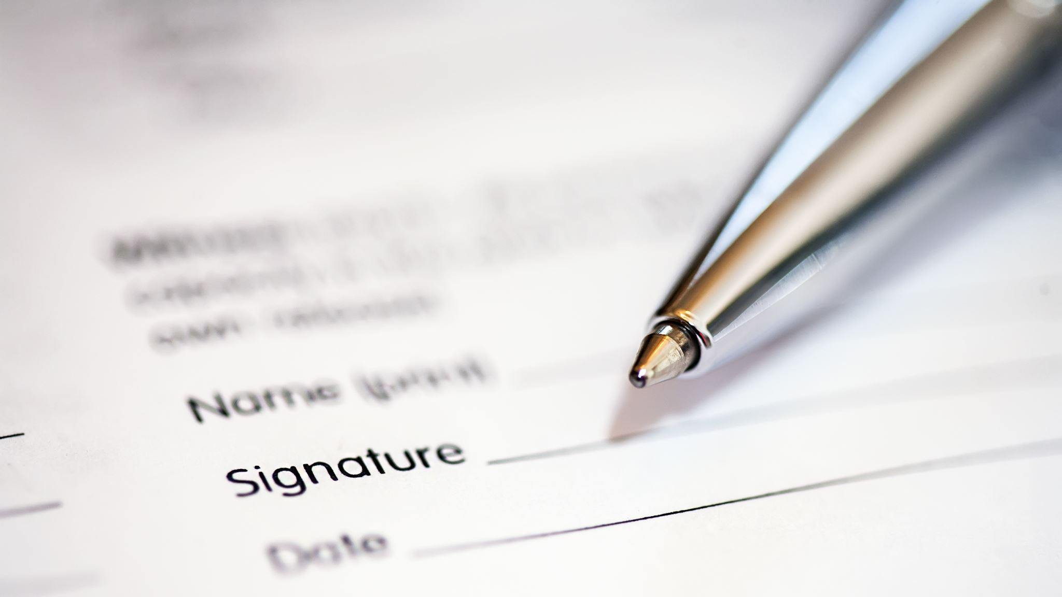
Acceptance Criteria

Slide 21
KEY | SUMMARY | LABEL
Key-10 | 1.Given that a user is an educator, he/she would like to get an update about the new features that have been added on the Smart Grader application. 2.Given the user is a student ,he/she would like to get an update about the new features that have been added on the Smart Grader application. | Login Page
Key-8 | 1.Given the user is a student or educator ,he/she should be able to find the logout page and should be able to logout of the application successfully. | Homepage
Key-20 | 1.Given the user is a student, he/she should be able to get a list of subjects for which they would be getting assignments for. 2.Given the user is an educator ,he/she should be able to get a list of subjects for which they would be creating new assignments. | Login Page
TJ RABBANI

Slide 22

Test Cases

Slide 23
TEST CASES FOR​ | KEY | TEST CASES​ | TEST DATA | EXPECTED RESULTS​ | ACTUAL RESULT | Pass/Fail​
Homepage​ | Key-8 | Logout button | Users could not log out of their accounts. | Every user should be able to log out of the application. | Every user would be able to find the logout option in the top right-hand side of the page . | Pass​
​Login Page | Key-10 | Feature button | New feature updates would be visible. | Every user should get an update of the new features that have been added to the Smart Grader. | Every user would be able to find the feature button on the top of the login page. | Pass​
TJ RABBANI

Slide 24
TEST CASES FOR​ | KEY | TEST CASES​ | TEST DATA | EXPECTED RESULTS​ | ACTUAL RESULT | Pass/Fail​
​Homepage | Key-20 | Subject button | Displaying Subject | Every user would be able to locate a button which will display all the subjects for which they can get/create assignments. | After the user login to the application every user would be able to locate 'subject' dropdown on the left-hand side of their page. | Pass​
TJ RABBANI

Slide 25
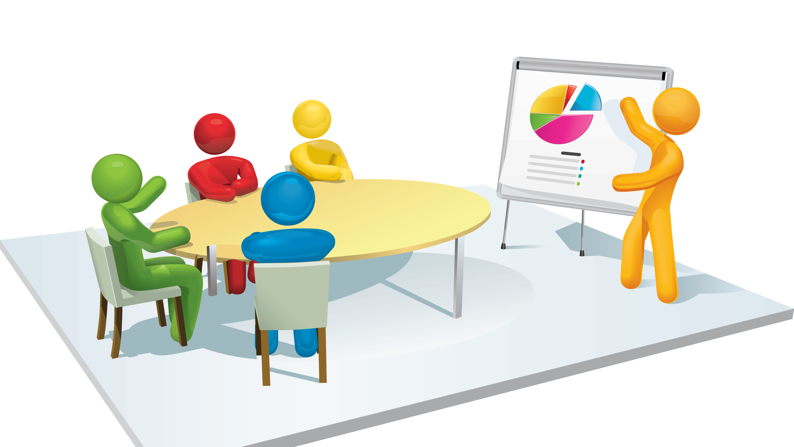
Project Demo
Watch SmartGrader Application Demo
https://github.com/joseph-dougal/CS691/blob/main/Powerpoint/app_overview.mp4
JOSEPH DOUGAL

Slide 26
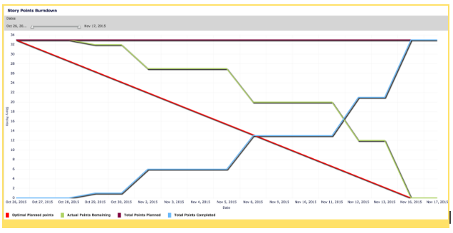
Burndown Chart

Slide 27
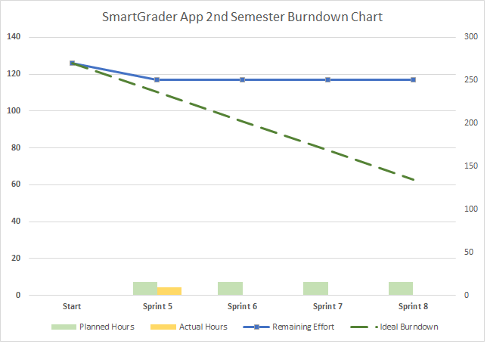
EMI HARRY

Slide 28
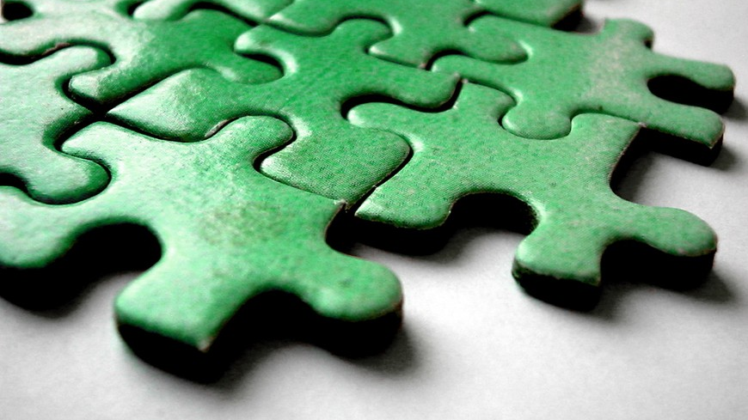
Product Backlog
This Photo by Unknown author is licensed under CC BY.

Slide 29
STORY/TASK | SUMMARY​ | KEY | PRIORITY
Story | As an educator, I want to add only the subject which I am teaching to my profile on Smart Grader. | Key-10 | High
Story | As a Student ,I want to have all the subjects I have taken for this semester to be displayed on my profile. | Key-11 | High
Story | As a Parent, I want to check the previous assignments of my child. | Key-18 | High
Story | As a head of Math's department, I want to check the math's grade of all class X students. | Key-20 | High
Task | Create presentation for Sprint 6. | Key-18 | Low
Task | Update installation guide and user manual. | Key22 | Low
Task | Update Technical Paper. | Key-23 | Low
Task | Update Smart Grader wiki page. | Key-24 | Low
EMI HARRY

Slide 30
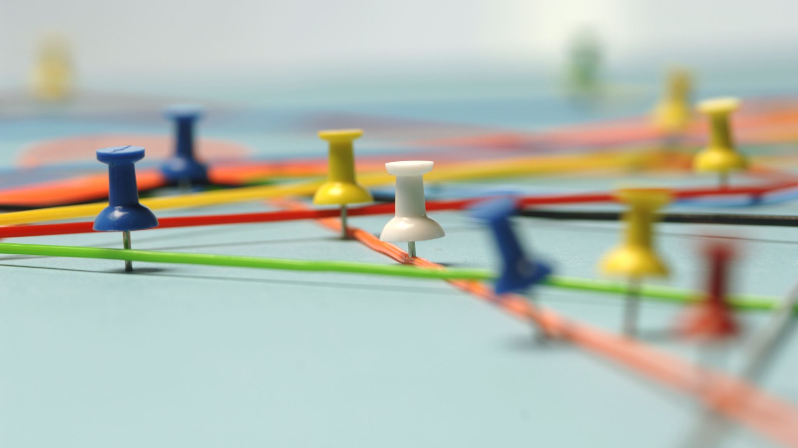
Timeline

Slide 31
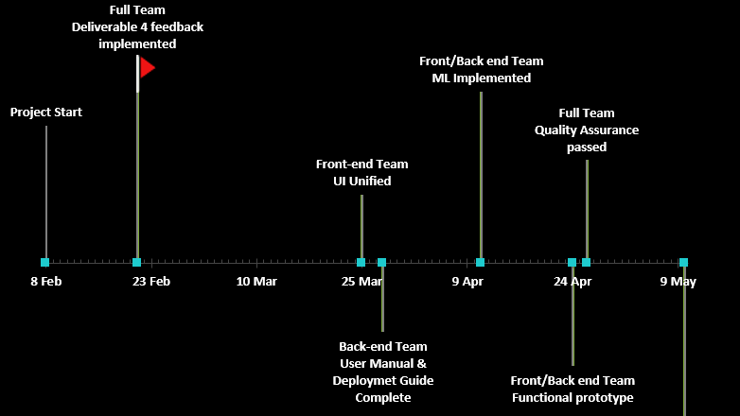
Final Deliverable presentation
EMI HARRY

Slide 32

Retrospective
What went well:
Weekly meetings for discussing the upcoming events related to the project.
Wiki Page for the team has been updated with the project demo video.
What needs to be improved:
Work on user stories and tasks in a timely manner.
What's next:
Go through the Google Bert documentation for better understanding
Set up team meetings for further discussion.
WAHIDUR RAHMAN

Slide 33

Conclusion
WAHIDUR RAHMAN

Slide 34


